Slide 1
Some thoughts about Accessor Methods
Nate Moehring
CLA, LabVIEW Champion
nate@themoehrings.com
LabVIEW Architects Forum
11/13/2014
Notes:
Opinions expressed are solely my own and do not express the views or opinions of my employer.
Does not contain intellectual property.

Slide 2
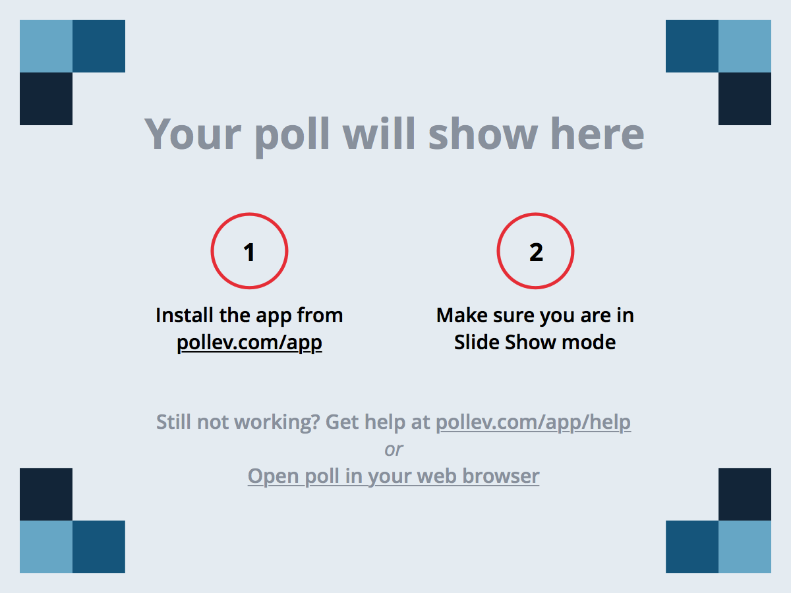
Notes:
Poll Title: What's your favorite thing about using LabVIEW?
https://www.polleverywhere.com/multiple_choice_polls/7ClxcmFfcOZYiVm

Slide 3
OOP 101
What are the main features provided by OOP compared to procedural programming?
What is the definition of encapsulation?
What are some benefits of encapsulation?
Notes:
This presentation is very hand-wavy, general guidelines. There are lots of exceptions to the guidelines I will propose here. The point is they are guidelines, best practices that should be kept in mind and willfully ignore them when needed.

Slide 4
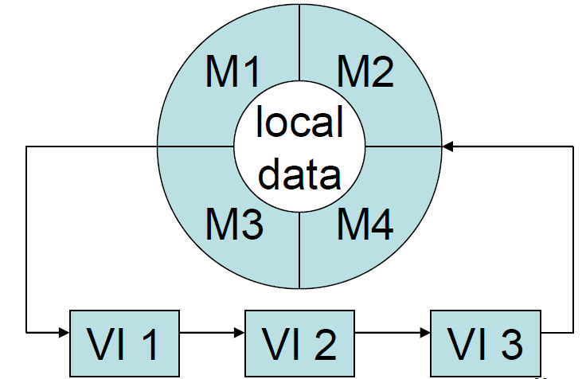
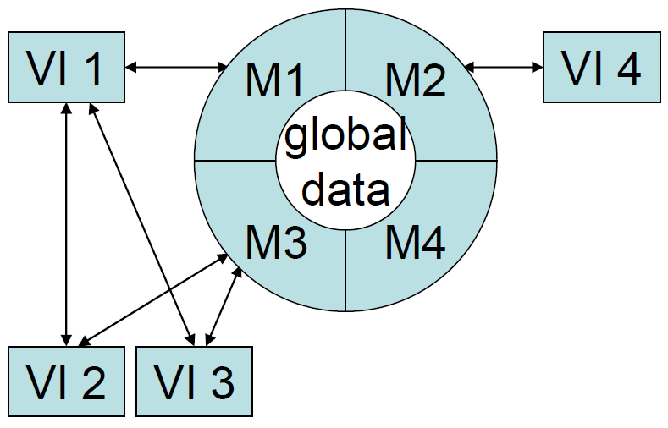
Encapsulation Illustration
Abstracts the details of object’s data storage
  Allows internal refactoring without affecting callers
Provides control over the data going in and out of an object
All data should be private until proven otherwise
Notes:
Similar to in a court of law where the suspect is innocent until proven guilty

Slide 5
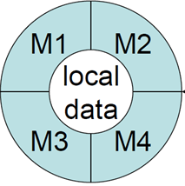
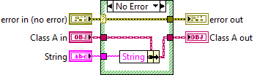
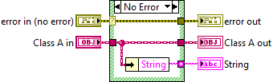
Accessor Methods PSA
A
A
Assuming a gentlemen’s agreement that you have not added code to Accessor methods:
  Public Accessors bypass Encapsulation
    Exposes structure of private data to clients
    Forfeits control over the data going in and out of obj
  Accessors that return references are the worst offenders
    Allows clients to modify state of object outside of dataflow
      I’m talking to you notifier/DVR members
Notes:
An accessor method is a particular type of method, typically autogenerated, that provides direct access to the data.
Sometimes this is required, many times it is abused.
An autogenerated method is a method generated by the IDE, whether that be LabVIEW or GOOP Development Suite. For GDS autocoded accessors, I expect them to only contain an IPE to dereference the private DVR, then read or write the data, nothing more except in rare circumstances.

Slide 6
Notes:
Poll Title: Do you put code in auto-generated Accessor Methods?
https://www.polleverywhere.com/multiple_choice_polls/xgBTrYTWaAn1yyN
During the LAF presentation it was suggested that a good use case for adding a small amount of code to the autogenerated method is to set a dirty flag to indicate to the client that the state has changed. This sounds good to me, though I still question whether the Write Accessor Method was really needed in the first place, rather than a normal method that potentially accepts multiple parameters and potentially does additional work on the data.

Slide 7
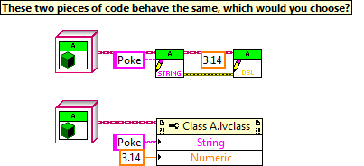

Accessors as Properties
Imagine setting 10 properties instead of 2
Property nodes are great for conserving space
Comes with occasional linkage issues…
Notes:
Methods for fixing linkage issues:
Might need to rewire the incoming object wire
Reselecting the correct property
Deleting and recreating the property folder?

Slide 8
Notes:
Poll Title: Do you call your Accessor Methods in Property Nodes?
https://www.polleverywhere.com/multiple_choice_polls/mv1ZMmop93Nwgzd

Slide 9
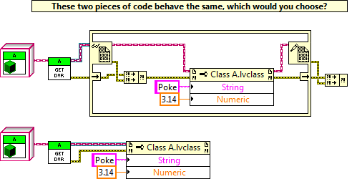
Accessing Object DVR Properties
This convenience encourages bad practice
  Makes it easier to create an accessor than to dereference the DVR and call a proper method.
  Breaks encapsulation, as discussed
  Potentially leads the developer to lock and unlock the DVR in multiple calls in what should be a single atomic action.
Notes:
Property methods can only have a single input and must have error clusters.
Out of curiosity, can anybody say authoritatively that the Object DVR is locked once at the beginning of the property node call and remains locked until the last accessor method has executed? Surely that’s the locking behavior right?
I have a merge VI in my palette so I don’t have to repeatedly redraw this IPE construct.

Slide 10
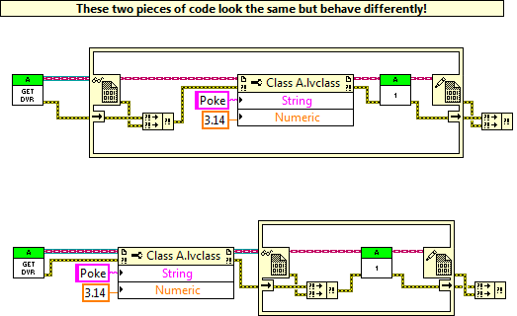
Accessing Object DVR Properties
Despite this, I’m still in favor of adding the ability to call methods on DVR using the invoke node. Let me make that decision.
Notes:
Some other process could modify the values of String and Numeric immediately after the properties have been set, and Method 1 would be operating on values other than what the author of this VI expected.

Slide 11
Notes:
Poll Title: Would you like to be able to dynamic dispatch on object DVRs, even at the risk of introducing race conditions if not managed correctly?
https://www.polleverywhere.com/multiple_choice_polls/Pg2Z541uc8ndMi6

Slide 12
Accessors are not substitutes for Initializer Methods
It is tempting to use a property node to quickly initialize a lot of object attributes because:
  May require a long string of accessors methods
  May create a hairy connector pane
  Can’t use a bundle node to set Parent data
However, initialization is better served by calling methods with required inputs.
  Perform sanity checks on input data
  Help ensure all required data is provided today
  Help ensure all required data is provided in the future by breaking callers if new attributes are added in the future that require initialization.

Slide 13
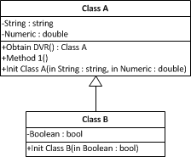
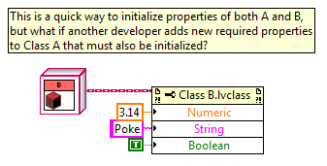
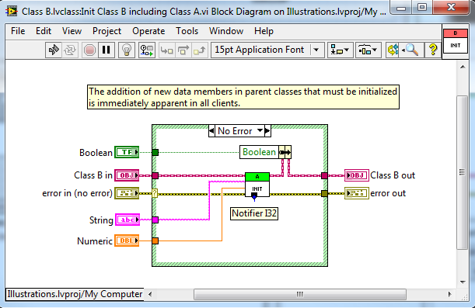
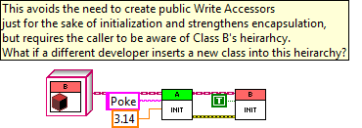

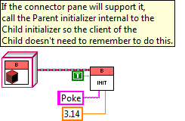
Accessors as Initializers

Slide 14

Rules of Thumb for Accessors
Data should stay in the class whenever possible
  Allow the object to do the work for you, rather than having the client operate on the data.
Favor methods over accessors
  Better access control and abstraction
Think really hard before creating a public Write accessor
  “Should someone ever need to set this value after the object has been initialized?”
Notes:
When developers are making the switch from procedural programming to object oriented programming, they often make the mistake of using the object as a cluster, reading and writing data from it, and not looking at the object as something that can do work for you.

Slide 15
Rules of Thumb for Accessors
Use bundle nodes to avoid creating accessors
  Reduces VI count
  Strengthens encapsulation
  I understand that people like accessors for searchability and debuggability. That’s fine, just make them private or protected.
Use Init methods for object initialization, not properties
  [Use connector panes for passing data to methods, not properties]
Consider making accessors protected so only child classes can call them
Notes:
Avoid returning references if possible. Instead, the method should act on the reference inside the method call.
Classes should either be all by-value or all by-reference. Mixing the two has undesirable results when branching or comparing objects.
[Consider use of GDS for creating by-ref classes that have better support for dynamic dispatch than DVR of object.]

Slide 16
Suggested Method Naming
Read/Write for Accessors
Get/Set for methods that act like Accessors but do not guarantee a straight pass-thru of data. Additional operations may be performed.
Find/Lookup/Store/etc for true methods that operate on the object data.
By value classes:
  Initialize/Clear: constructor/destructor
By reference classes:
  Create/Destroy: constructor/destructor
  Clone: copy constructor
  isEqual: equality comparison

Slide 17
Notes:
Poll Title: Do you have naming conventions to help yourself or others understand how to use your classes correctly?
https://www.polleverywhere.com/multiple_choice_polls/LZ0dOyUVLUxVhI4

Slide 18
Thoughts about References in Classes
Storing a reference in an object is risky because it breaks encapsulation
  The object has no control over the lifetime of the reference
    LabVIEW reference lifetime: destroy when creator stops
    Parallel process could destroy reference anytime
  Data can be updated at any time outside of the methods
Creating references internal to an object is risky because it may not be obvious to the user
  If the object looks by value, the user may not be aware that forking the wire is not creating a copy of ALL the data
A Read accessor that returns a reference is more dangerous than a by-val Write accessor.
Both of these may be by-design, but both the author and the user need to be well aware of it.
Notes:
Exceptions:
Message classes (like AF), where the purpose of the class is to transport data.
References that are a communication mechanism to an OO-actor, obviously other people need a way to communicate with your actor.
GDS-style classes where the private data is a DVR to a typedef cluster (the user must be aware of the rules regarding the proper use of by-ref objects, the GDS naming conventions help)

Slide 19
Notes:
Poll Title: Do you put references in by-value objects?
https://www.polleverywhere.com/multiple_choice_polls/H8MezEzgMR0SKTD
Sometimes its completely necessary and understandable, such as file references, TCP, message queues to actors, etc…

Slide 20
Your Thoughts?

